Slide 1


1

Slide 2
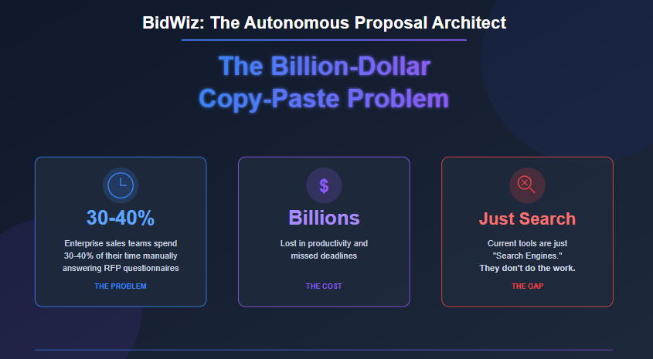
Problem Statement
2

Slide 3
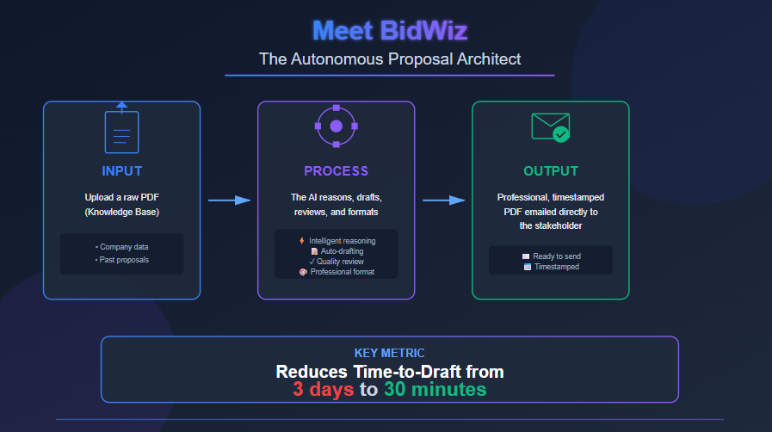
Proposed Solution
3

Slide 4
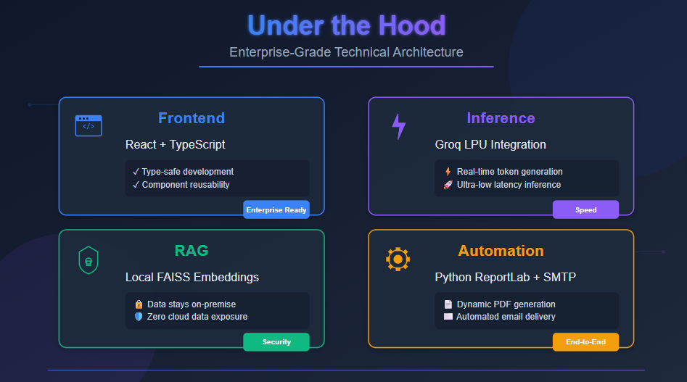
Under the Hood
4

Slide 5

Market & Business Viability
5

Slide 6
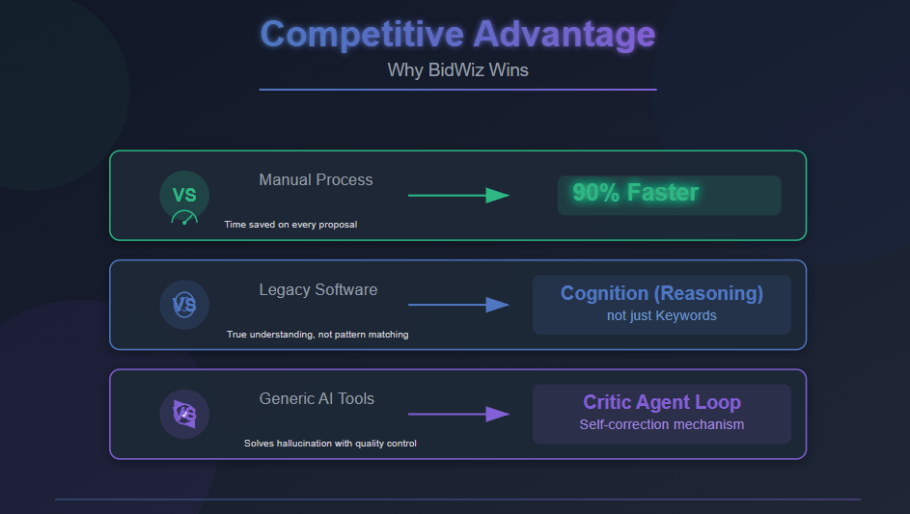
Competitive Advantage
6

Slide 7
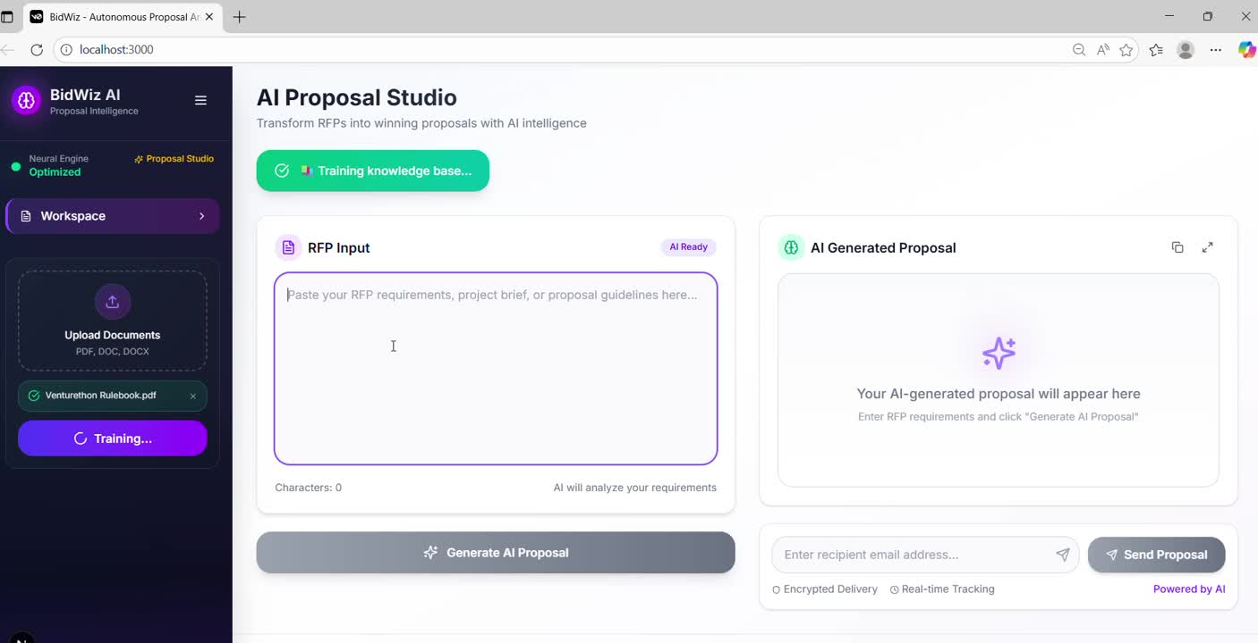
Live Demo
7

Slide 8
Thank you
8

